Slide 1

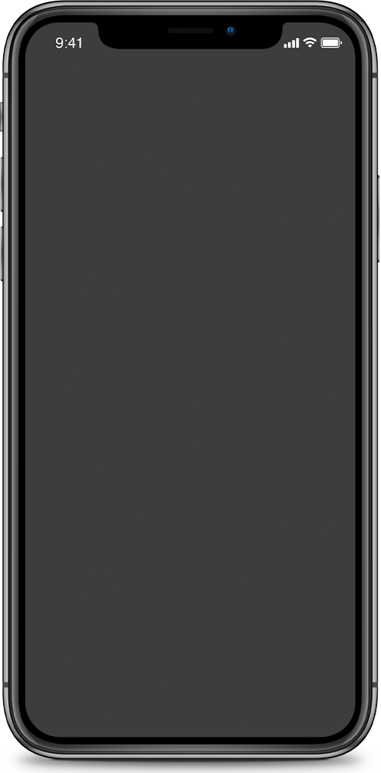
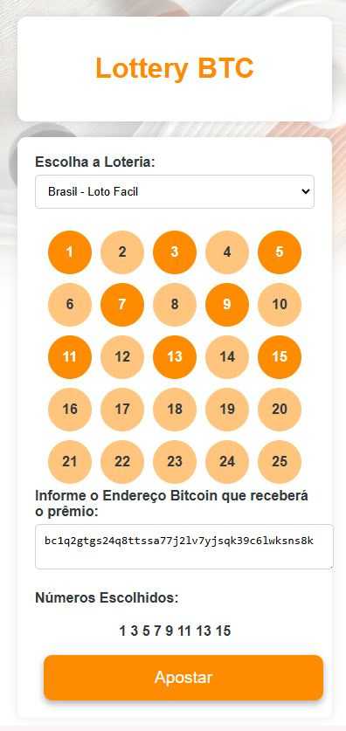
Be your own lottery
Lottery BTC
Decentralized and distributed financial solution for fundraising, winner identification and automatic prize payout

Slide 2
Platform Decentralized betting using Bitcoin
Automated capture of official lottery results
Automated payments in BTC
Secure and anonymous betting
In this Presentation
Here's what we'll cover:

Slide 3

Technology Delivers!
Prohibition and Excessive Government Regulation.
Fragile Anonymity
Lottery Fraud
Difficulty in Claiming award.

Slide 4
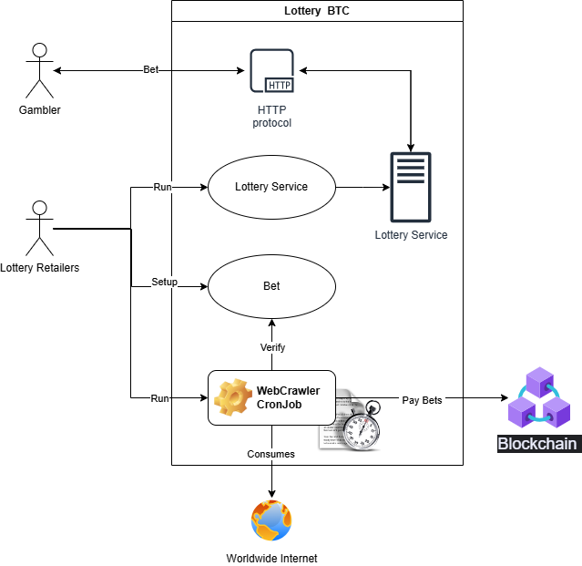

Proposed solution
Lottery Retailers are committed to running LotteryBTC.
LotteryBTC provides an online betting service.
LotteryBTC schedules the periodic execution of WebCrawler.
WebCrawler periodically visits the configured Bet’s pages.
WebCrawler pays out winnings to Retailers if it identifies a winning bet.
/ Betting Shop

Slide 5
Betting shop
or
Loterry Retailers

Slide 6
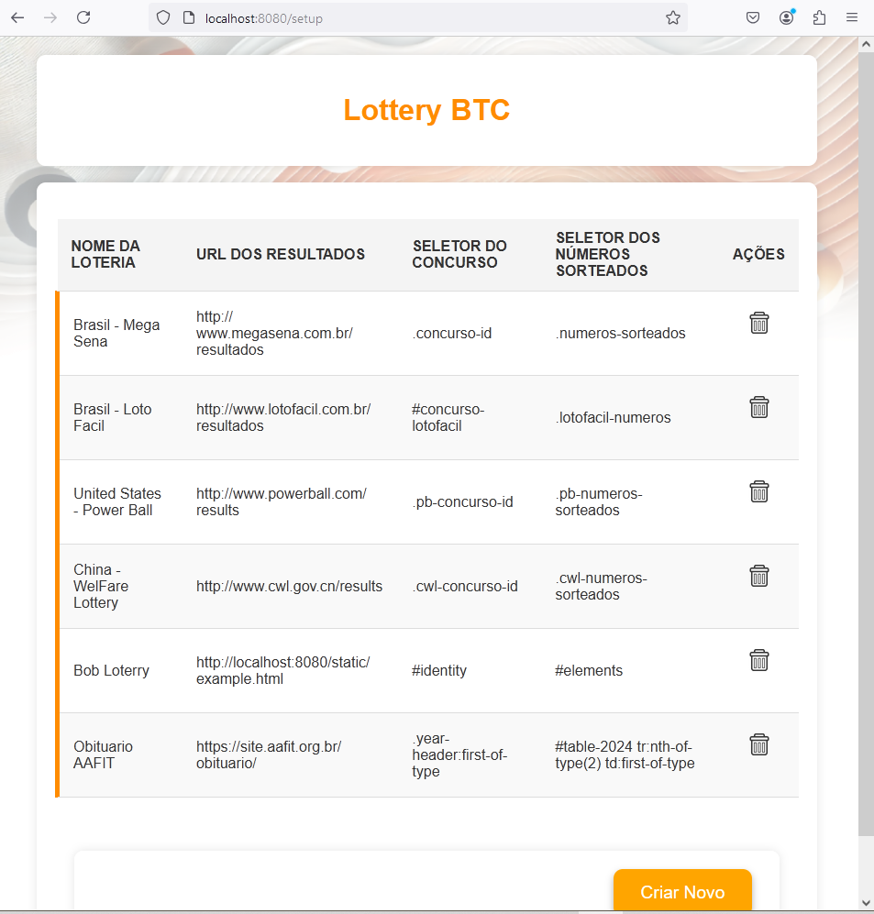
FLEXIBLE SETUP BETTING | Easily collect draw results from virtually any available webpage on the internet. Simply provide the desired URL and the CSS selectors to identify both the event (or contest) and the drawn elements (like lottery numbers, for example). You can set up bets for lotteries such as Mega-Sena, Powerball, or any other. Why not go further and register predictions for specific sections of sites like CNN’s or Fox News’s homepage? If it's online, you can turn any event into a draw!

Slide 7
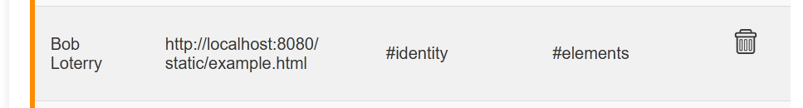
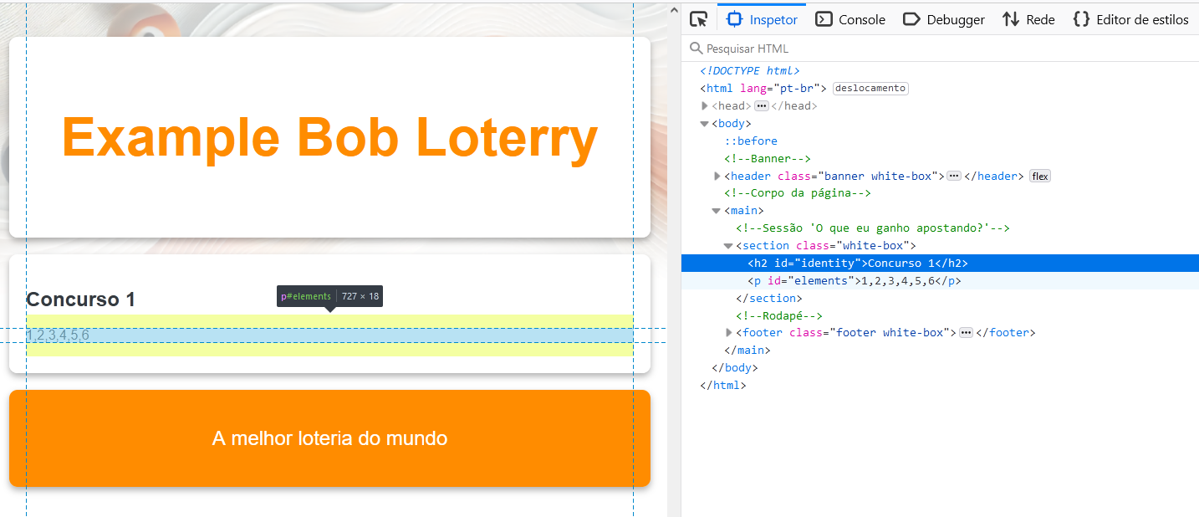
How does the Registration Work?
Any content from a web page can be referenced using CSS selectors.
This content can be used by a WebCrawler to capture information and process payments

Slide 8
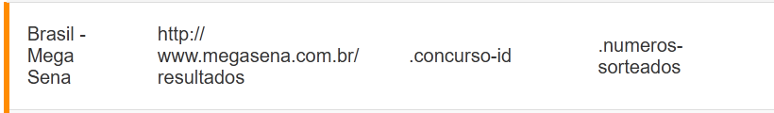
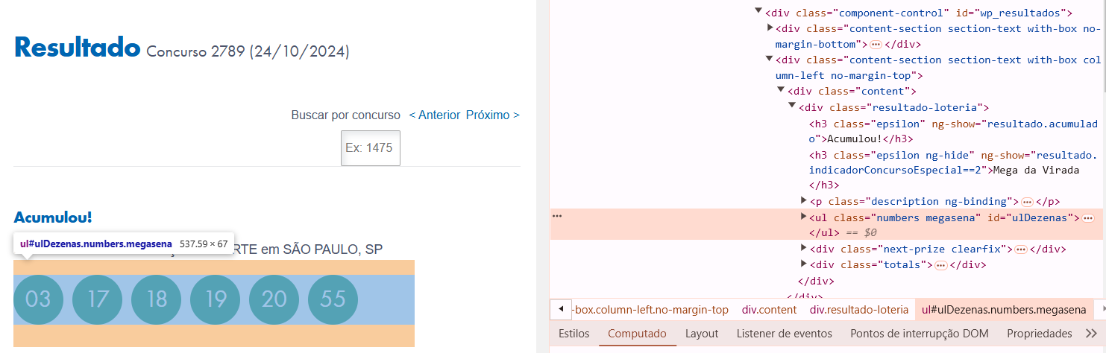
How does the Registration Work?

Slide 9
Gambler

Slide 10
Flexible Selection of Drawn Elements
Numbers, Names, Animals, colors, ...
Using Lotofácil or Powerball as examples, the interface can be configured to allow selecting only numbers within the drawn range.
However, since the draw is external, it is also possible to accept bets on animals, colors, names, news, or any text available online to pay the bettor.

Slide 11
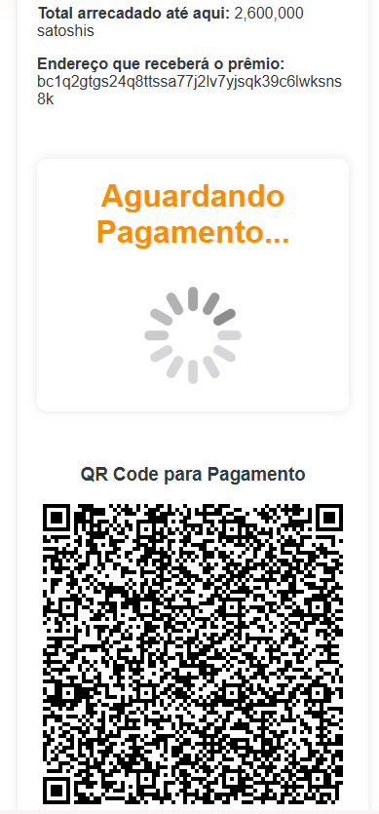
Payment and Confirmation through Lightning
Based on the chosen lottery type, betting options relevant to that lottery will be provided.
For example, in Mega Sena, numbers are always drawn between 01 and 60, while in the China Welfare Lottery, the range is from 01 to 33.
The bettor must also provide either an on-chain public key (not yet available) or a Lightning invoice, which will automatically receive the full wallet balance if the Crawler identifies the bet as a winner.

Slide 12

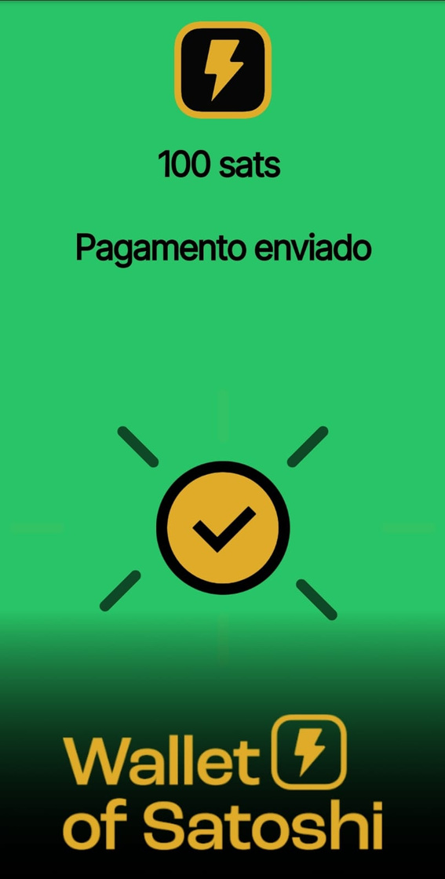
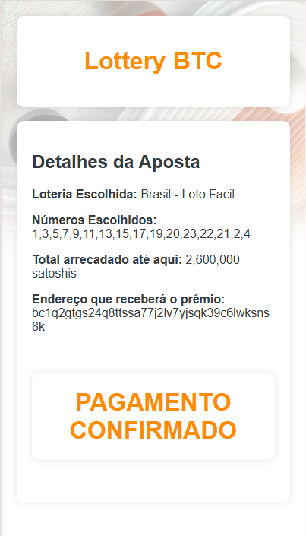


Slide 13
Web Crwolers

Slide 14

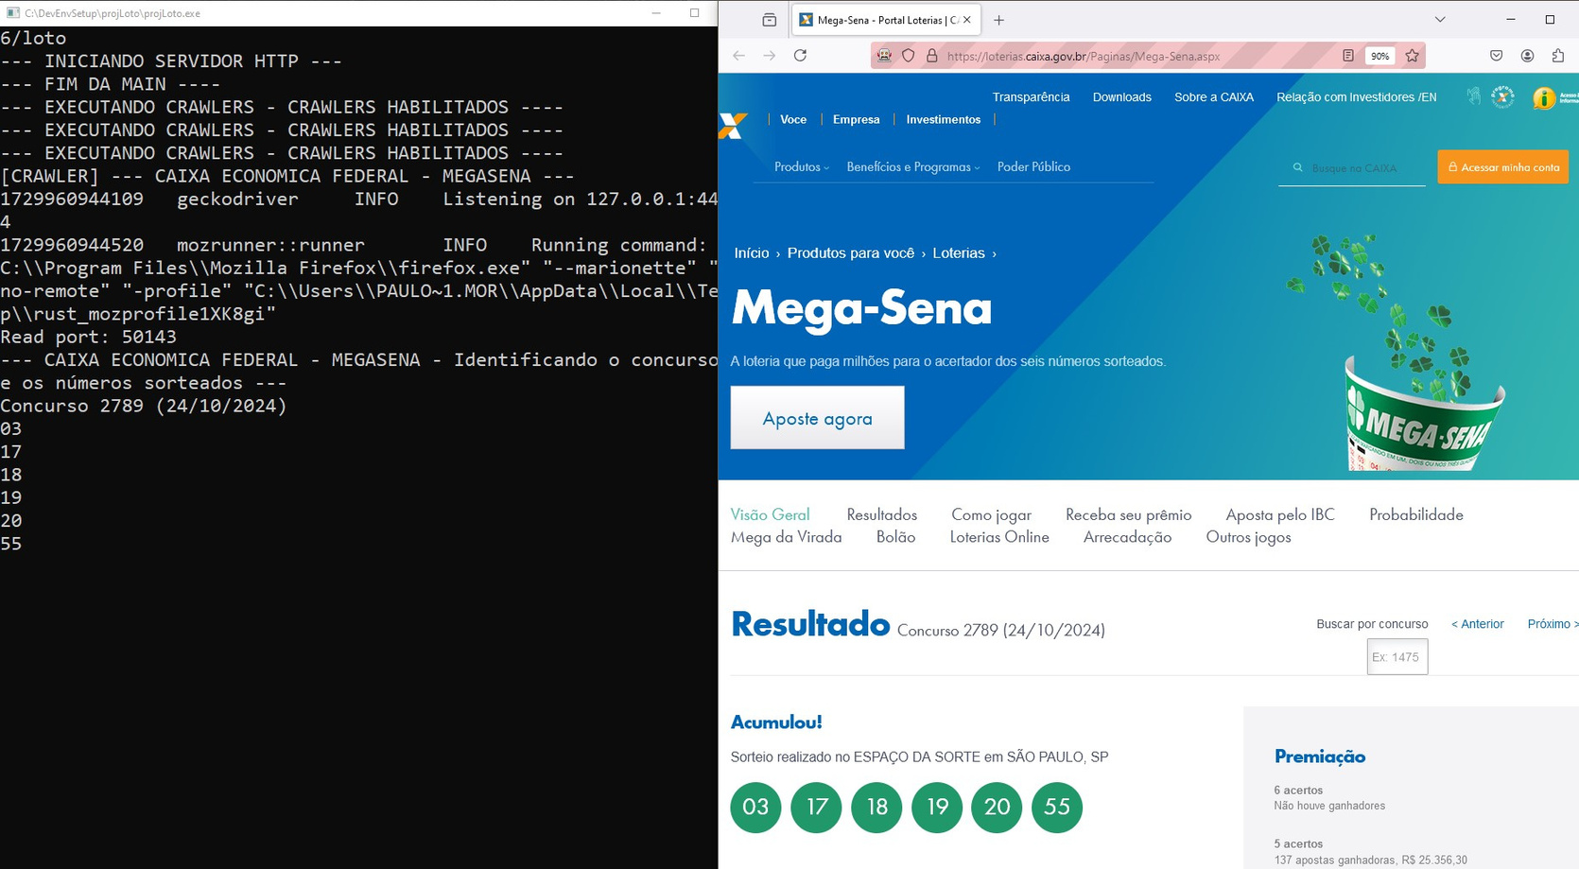

Dynamically Configurable Web Crawler

Slide 15
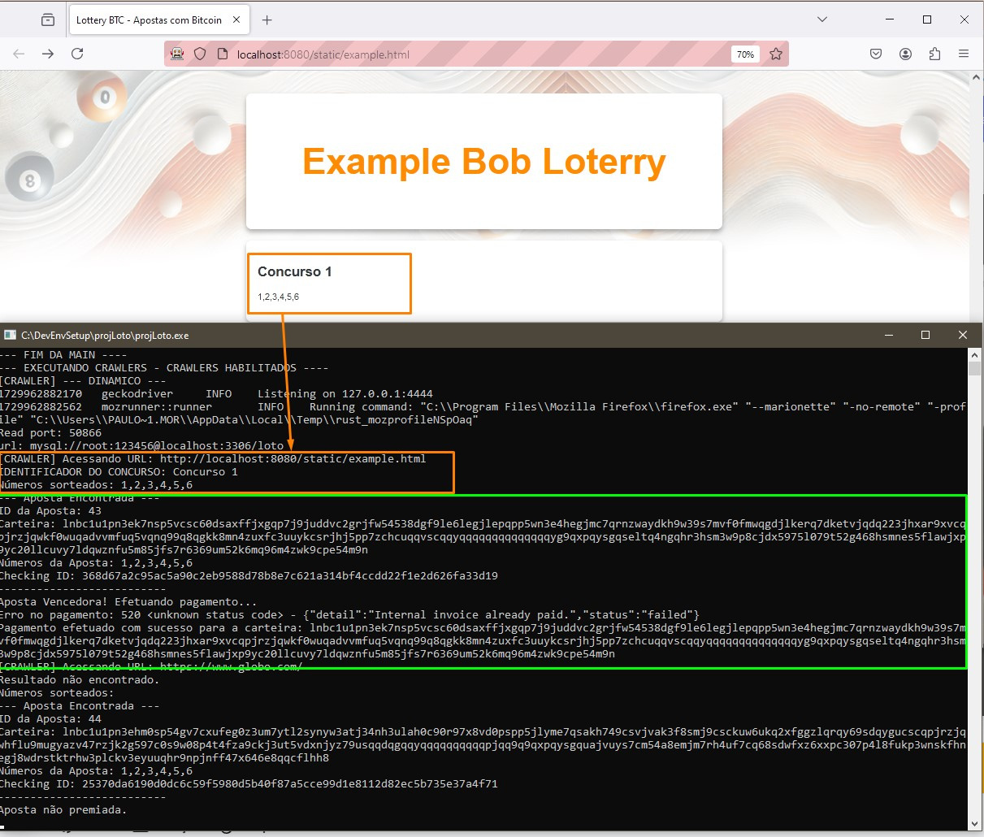
Automatic Payment Web Crawler
An automatic crawler will continuously visit the registered website address.
If winning bets are identified, the crawler will automatically execute a transaction to pay the winners, distributing nearly all the collected funds quickly, anonymously, and securely.

Slide 16

Any website available on the internet can be used as a data source for lotteries.

Slide 17
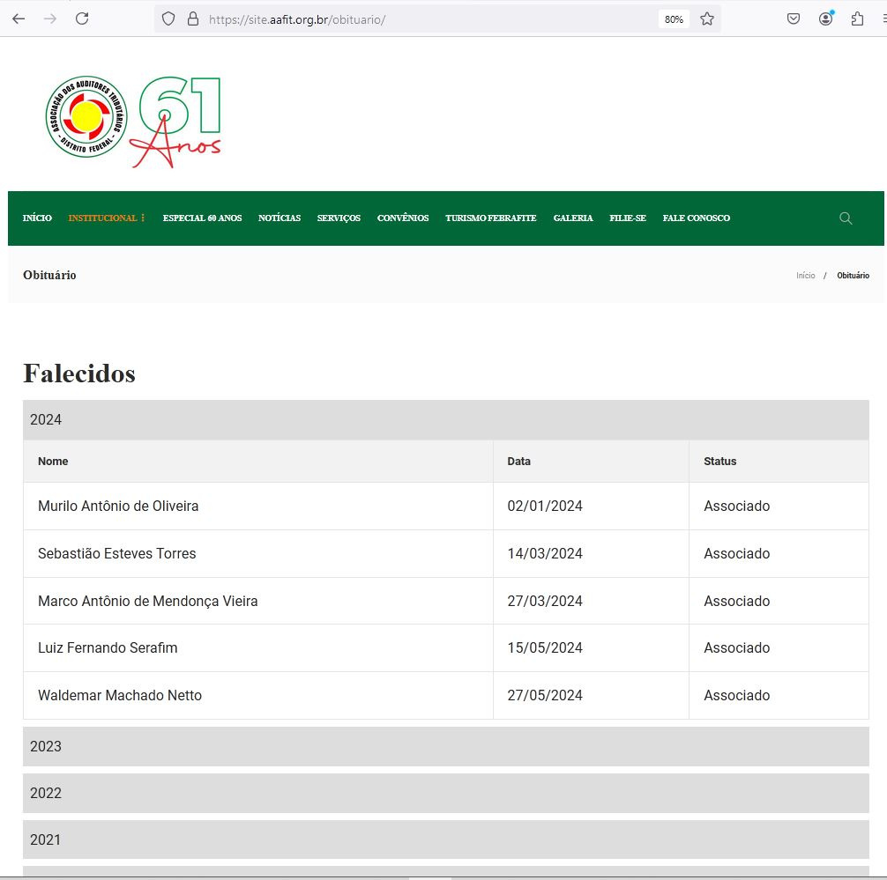
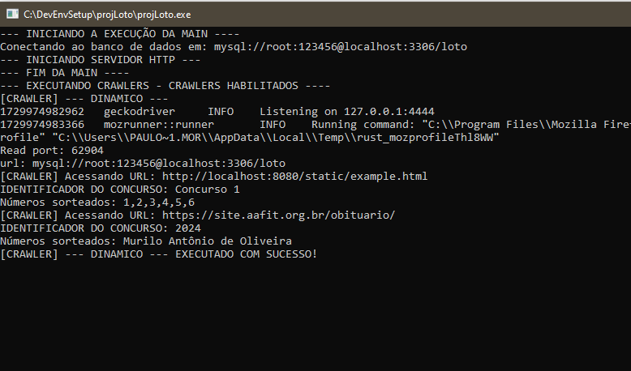
Respectfully, I present this example
Our sincere condolences to those who have lost loved ones
Even an obituary website could be used as a data source to feed the system.
It would only be necessary to register the website address and define a CSS selector to identify the event and another to identify the value of the elements used for processing the bets.
Note: The betting screen currently only allows betting on numbers.

Slide 18
Proposed Evolutions
If a model were created where part of the key remained encrypted in the crawler, and the other part was unlocked by the drawn numbers.
Any bettor could run the crawler and enforce the payment of all bets.

Slide 19






Used Technologies

